Slide 1
DAY PLANNER
Microsoft Engage’21
Project PPT
Submitted by:
Mukul Goyal
mklgoyal167@gmail.com

Slide 2
The Challange
Build a functional prototype of a platform that gives students an array of digital academic and social tools to stay engaged with their studies, peers and broader university community during pandemic.

Slide 3
MY BIG CONCEPT
Project aim to provide a plateform where students could store their plan for day activities they want to do.
This helps in their productivity.
DAY PLANNER

Slide 4
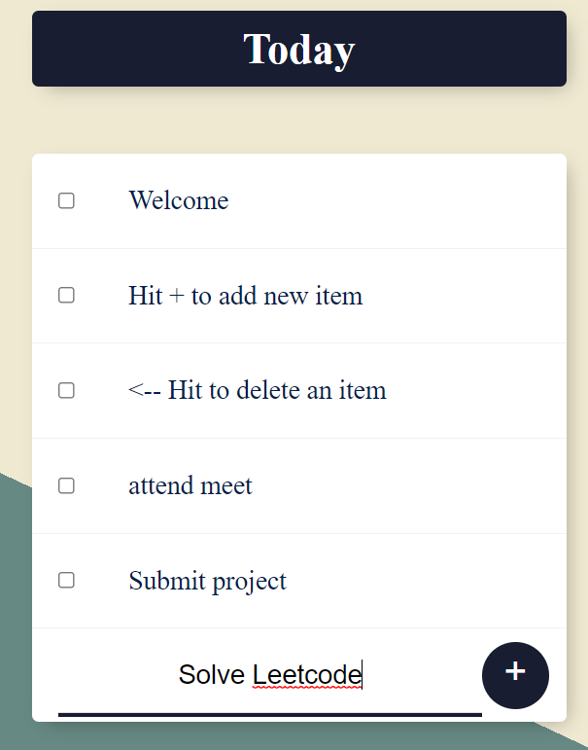
Landing Page
Landing page will be simple and beautiful.

Slide 5

Add Task
Add task by writing in the input box and hiting on + button.

Slide 6
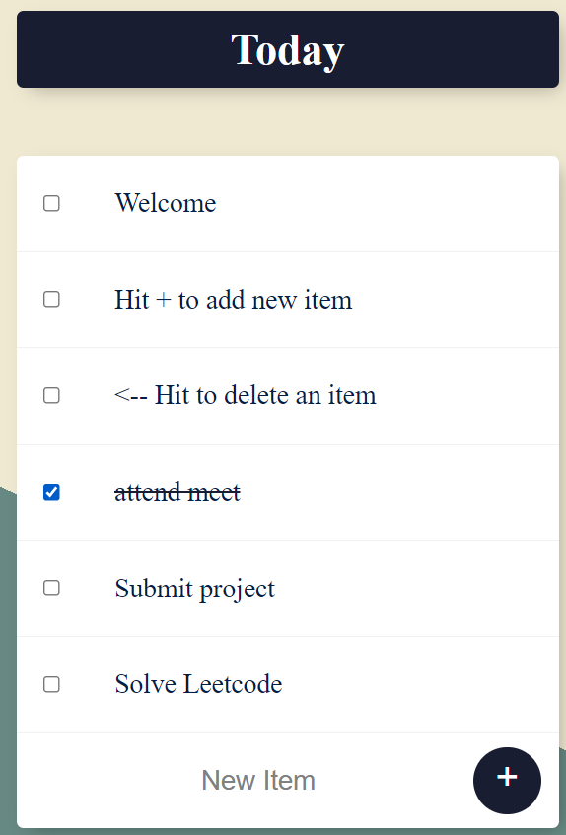
Cut Task
Cut task by writing hitting on the checkbox of that task.

Slide 7
Technologies Used
HTML
CSS
JavaScript
Node
Express
EJS Templating
MongoDB
Mongoose
Heroku
Hosted the wesite on Heroku, and its server on MongoAtlas.

Slide 8
Check the site here...
https://hidden-garden-39685.herokuapp.com/
Thankyou...
Submitted by:
Mukul Goyal
mklgoyal167@gmail.com

